Slide 1


Mass fit status NTUA 21/5/2020
George Bakas

Slide 2
Status Report
Training with Mass Cut (50,300)GeV @ preselection
Larger ttbar contamination vs the previous BDT that has no mass selection criteria
Mass Fit
Cannot understand why the k_{slope} is so big when we implement the fit
Can it be due to statistics??
Simultaneous fit seems to have better results (qcd params are frozen)

Slide 3
New training with mass cut: 50 < m_{top} <300 GeV
With mass cut
Without mass cut

Slide 4
Signal Selection
Control Region Selection
Variables | Selected Cut
pT (both leading jets) | > 400 GeV
Njets | > 1
N leptons | = 0
|eta| (both leading jets) | < 2.4
mJJ | > 1000 GeV
jetMassSoftDrop (only for fit) | (50,300) GeV
Top Tagger | > 0.2
B tagging (2 btagged jets) | > Medium WP
Signal Trigger
Variables | Selected Cut
pT (both leading jets) | > 400 GeV
Njets | > 1
N leptons | = 0
|eta| (both leading jets) | < 2.4
mJJ | > 1000 GeV
jetMassSoftDrop (only for fit) | (50,300) GeV
Top Tagger | > 0.2
B tagging (0 btagged jets) | < Loose WP
Control Trigger

Slide 5
Simultaneous Mass Fit
0-btag
2-btag

Slide 6

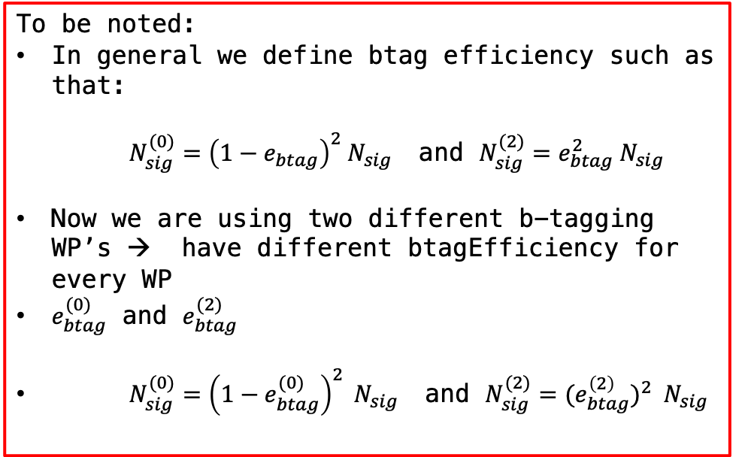
Simultaneous Mass Fit Result
Floating Parameter FinalValue +/- Error
-------------------- --------------------------
btagEff_0 9.5471e-01 +/- 5.62e-02
btagEff_2 7.2228e-01 +/- 7.93e-02
kMassResol 9.5237e-01 +/- 2.74e-02
kMassScale 1.0003e+00 +/- 2.02e-03
kQCD_2b 9.4207e-01 +/- 1.73e+00
nFitBkg_0b 7.8461e+01 +/- 1.22e+01
nFitBkg_2b 2.3596e+02 +/- 2.28e+01
nFitQCD_0b 2.0016e+03 +/- 6.98e+01
nFitQCD_2b 2.8212e+03 +/- 1.43e+02
nFitSig 1.0452e+04 +/- 2.10e+03
N0_observed = 21.4402, N2_observed = 5452.96
Ntt observed (all regions): 5474.4
Ntt expected (all regions): 7872.02
Signal strength r: 0.695426 (both 2 and 0 btag regions)
Singal strength r in 2btag: 0.69463 (only for 2btag region)
Singal strength r in 0btag: 0.981499 (only from 0btag region)
To be noted:
In general we define btag efficiency such as that:
$N_{sig}^{(0)}={\left(1−e_{btag}\right)}^{2} N_{sig}$ and $N_{sig}^{(2)}=e_{btag}^{2} N_{sig}$
Now we are using two different b-tagging WP’s → have different btagEfficiency for every WP
$e_{btag}^{(0)}$ and $e_{btag}^{(2)}$
$N_{sig}^{(0)}={\left(1−e_{btag}^{(0)}\right)}^{2} N_{sig}$ and $N_{sig}^{(2)}={{(e}_{btag}^{\left(2\right)})}^{2} N_{sig}$

